Slide 1

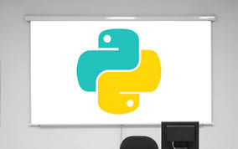
2024 Data Science & AI Symposium
Introduction to Data Structures
in Python
June 29, 2024

Slide 2
Instructors and Teaching Assistants
Solomon Etiyeme Promise: Instructor
Joseph Luper Tsenum: Instructor
Emmanuel Ocholi Benjamin: TA
Gabriel Terkuma Saaondo: TA
Mfeuter Joseph Tachia: TA

Slide 3
Outline
Definition of Python and its applications
Benefits of Python programming
Types of Data Structures
Types of Python Functions
Data structures in Python

Slide 4
Why Python?
Python is an interpreted, object-oriented, high-level programming language applied in:
Data manipulation (e.g, libraries such as pandas, numpy, polars, etc)
Data visualization (e.g, plotly, matplotlib, seaborn, etc)
Statistical analysis (e.g, scipy, statsmodels, etc)
Machine Learning (e.g, JAX, keras, theano, XGBoost, scikit learn,
Tensorflow, PyTorch, etc)
Natural Language Processing (NLP): E.g, NLTK, BERT, spaCy, Genism, TextBlob, Polyglot, pattern, etc
Database operations (e.g, PySpark, Dask, Hodoop)
Time series analysis (e.g, sktime, Darts, Prophet, tsfresh)
Web scraping (e.g, Scrapy, beautiful soup, selenium

Slide 5
Benefits of Python Programming
Data visualization
Data analysis
Automation
Artificial intelligence
Software development
Prototyping
Web application
Machine learning
System scripting
Workflows
Mathematics
Web development
(server side

Slide 6
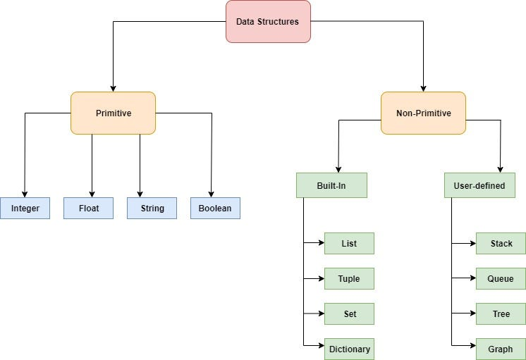
Types of Data Structures
Basic (hold a single value)
Complex (hold multiple values)

Slide 7
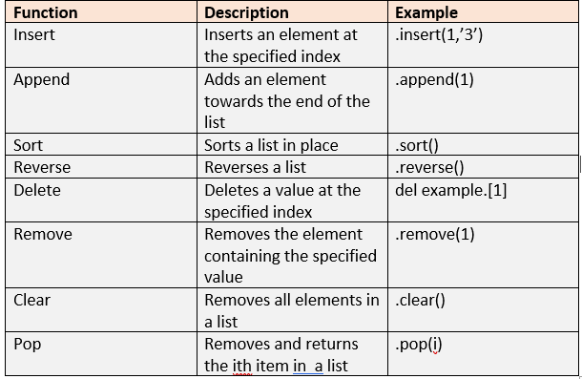
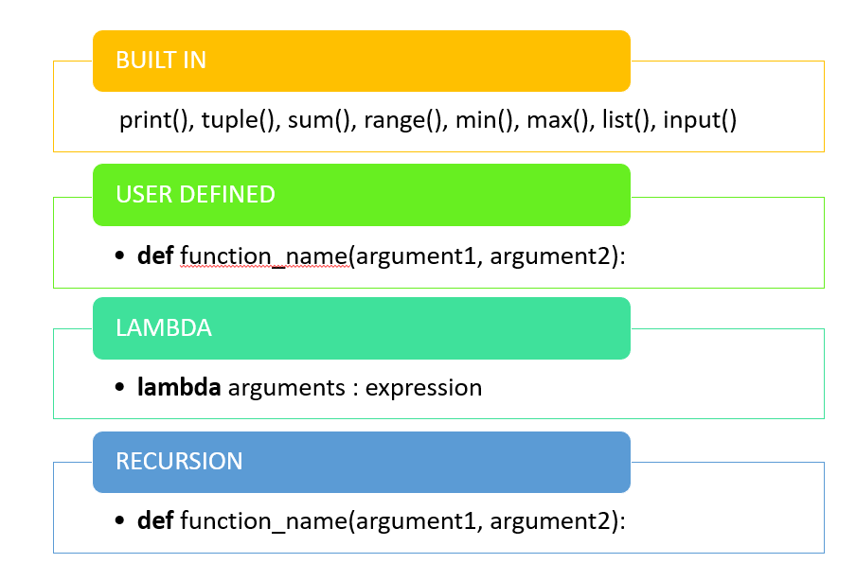
Types of Python Functions

Slide 8
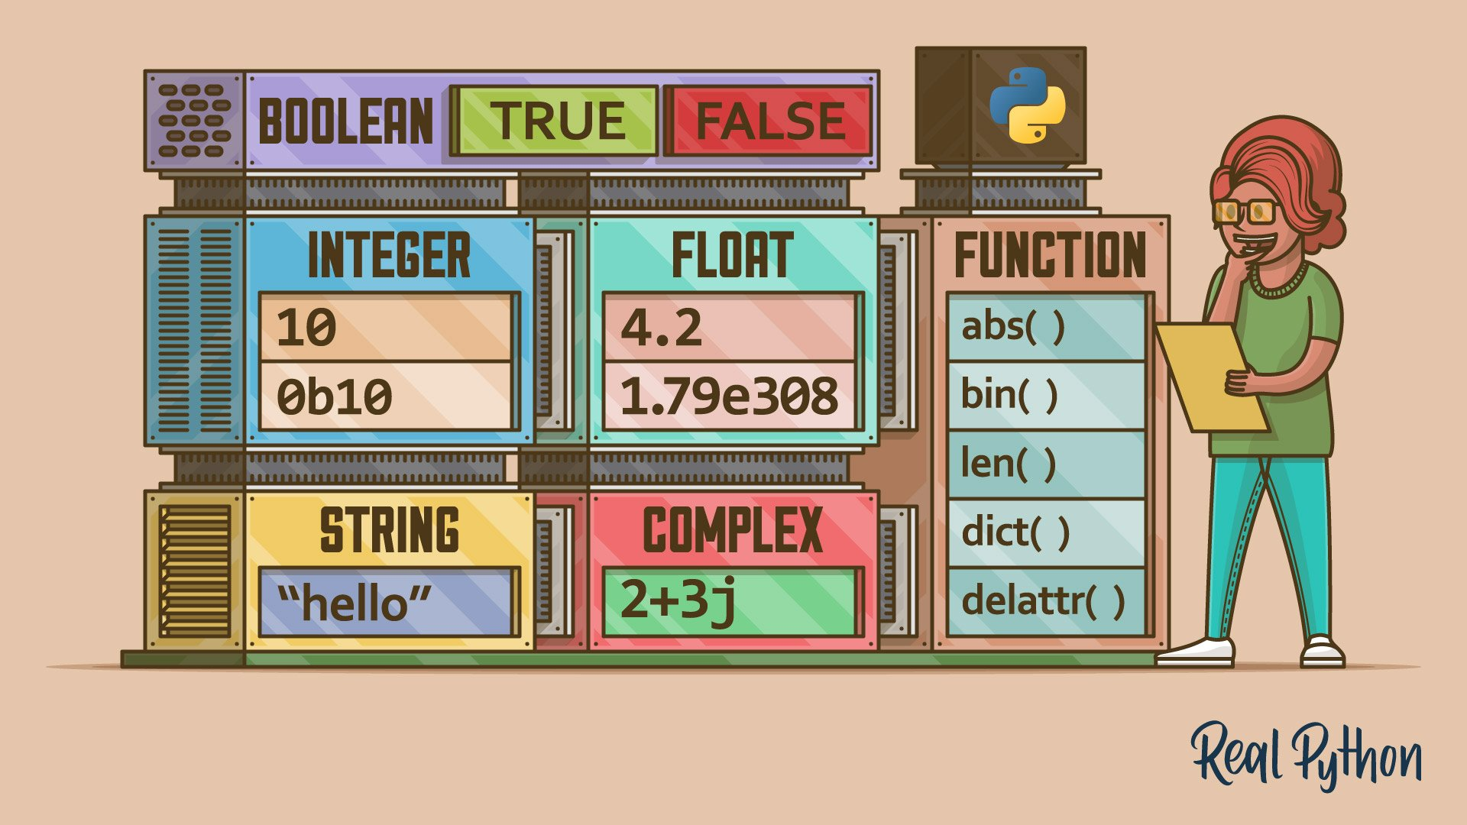
Data structures in Python

Slide 9
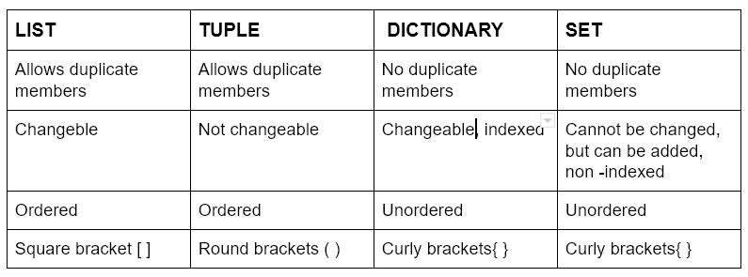
Characteristics of Python Data Structures

Slide 10
Q/A

